Slide 1
Train on Less == Pay for Less ?
Can we train on less data and save time? · Mid-term presentation
Team DataDiet
Rahul Paul (26M2102) · Ayan Barman (26M0761) · Banibrata Manna (26M2114) · Tejas Itankar (26M0778)
CS 725: Foundations of Machine Learning · Prof. Sunita Sarawagi · IIT Bombay
Notes:
Good morning everyone. We are Team DataDiet. I am Rahul Paul, and my teammates are Ayan Barman, Banibrata Manna and Tejas Itankar.
Our project is called "Train on Less equals Pay for Less?". The question is simple: if we train a neural network on fewer training pictures, do we really save time, and do we still get the same accuracy?
In the next few minutes we will show why this question matters, what we built, what we found on the CIFAR-10 dataset so far, and what we will do after the mid-term.

Slide 2
Training a network is expensive
MOTIVATION
3,000,000
× many
= cost
image views in ONE small training run: 50,000 images × 60 epochs
runs: every new setting or retry pays the full cost again
GPU time, money and energy, growing as datasets get bigger
Normal training shows the model every picture, again and again. More data means more time.
DataDiet · CS 725 mid-term
2
Notes:
Let us start with why this matters.
When we train a neural network, it looks at every training picture, again and again. One full pass over all the pictures is called an epoch. Our dataset has 50,000 training pictures and we train for 60 epochs, so one single training run looks at a picture 3 million times. And this is a small dataset; real ones have millions of pictures.
On top of that, nobody trains only once. Every time we try a new setting, a new random seed or a new model, we pay the full cost again.
All of this costs GPU time, money and electricity, and the cost grows with the amount of data. So if we could train on less data, we would directly save time.

Slide 3
Not every training example is equally useful
MOTIVATION
Redundant
Informative
Harmful
Clear, typical pictures. Many look alike. The model learns them fast; after that they teach little.
Unusual or tricky pictures. The model can still learn from them.
Unclear pictures, or pictures with the wrong label. They confuse the model.
DataDiet · CS 725 mid-term
3
Notes:
But do we really need every picture? Think of revising for an exam: you do not keep re-reading the questions you already know; you practise the ones you keep getting wrong. Training data is similar. Roughly, pictures fall into three groups.
Redundant pictures: clear, typical pictures, like a red car in the middle of the photo. Many of them look alike. The model learns them in the first few epochs, and after that they teach it very little, but they still cost time in every epoch.
Informative pictures: unusual or tricky ones, like a strange angle or a small object. The model can still learn something from them.
Harmful pictures: some are so blurry that even a person cannot tell the class, and some have the wrong label in the dataset. These can actually confuse the model.
So if we could find the pictures that teach little and remove them, we could save time without losing much accuracy.

Slide 4
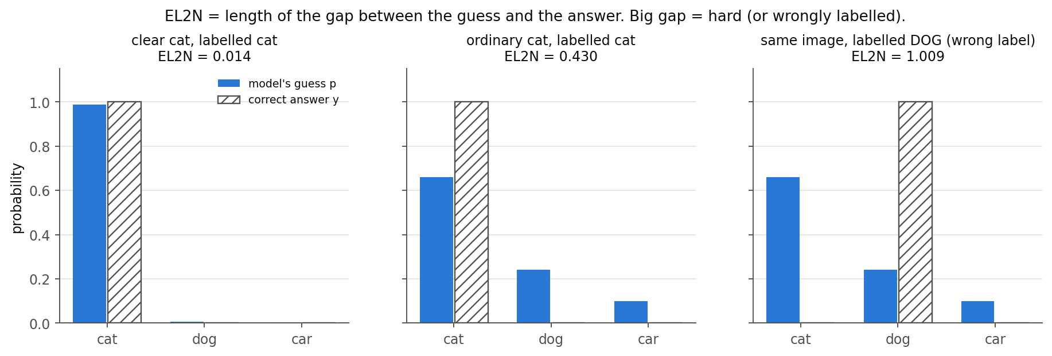
What “easy” and “hard” mean
DEFINITIONS
Easy example
Hard example
The model learns it quickly and soon gets it right with confidence. Low score.
The model is still wrong or unsure after a while. Often odd, unclear or wrongly labelled. High score.
EL2N = ‖ softmax(model output) − one-hot(true label) ‖
DataDiet · CS 725 mid-term
4
Notes:
To do that, we need to say clearly which pictures are easy and which are hard.
An easy picture is one the model learns quickly: early in training it already gets it right, and it is confident. A hard picture is one the model still gets wrong, or is unsure about, after training for a while. Hard pictures are often odd, unclear, or wrongly labelled.
We measure this with a number called EL2N, shown in the dark box. For every picture, the model gives a probability for each class; that is its guess. The right answer is written as 1 for the true class and 0 for all others. EL2N is simply the distance between the guess and the right answer.
The three charts show it. Blue bars are the model's guess, striped bars are the right answer.
- Left: a clear cat. The model says "cat" with almost 100%, so the gap is tiny: EL2N is 0.014. Easy.
- Middle: an ordinary cat. The model says cat with about 65%, so there is some gap: 0.43.
- Right: the same kind of picture, but labelled "dog" by mistake. The model's guess is far from that label: EL2N is about 1.0. Hard.
The score goes from 0, perfectly right, to about 1.41, completely sure of the wrong answer. We compute it with a model trained for only 20 epochs, and we average it over three such models to make it stable.

Slide 5
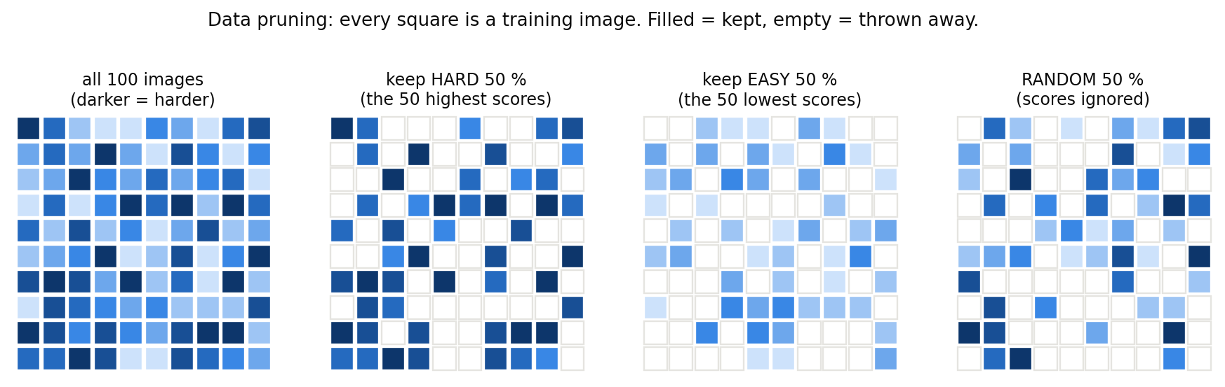
Data pruning: score, keep, train
MOTIVATION
Our question: making the scores also takes GPU time. Is the total (scoring + training) really less than training on everything?
DataDiet · CS 725 mid-term
5
Notes:
With this score, data pruning works in three steps, left to right in the picture.
Step 1, score: give every training picture its EL2N score.
Step 2, keep: sort the pictures by score and keep only a part of them, for example the hardest 70% or 50%. The rest are thrown away.
Step 3, train: train a brand-new model only on the kept pictures. With half the pictures, each epoch has half the work, so training takes about half the time.
Now the catch, written at the bottom. Step 1 is not free. To compute the scores, we first have to train a model, and that takes GPU time too. Most papers only report how much data they kept and how accurate the model was. They usually do not say how long the scoring took. Our project counts it.

Slide 6
Problem: train on fewer pictures, keep the accuracy, and save total time
PROBLEM STATEMENT
1
Pick a subset of the 50,000 CIFAR-10 training pictures so that ResNet-18 trained on it is within 1 point of full-data accuracy (94.3%).
2
Count everything: scoring time + training time on the subset must be less than one full training run.
3
Mid-term: measure the standard EL2N scorer against random picking and fewer epochs, for accuracy and for time.
Why it matters: models are retrained many times (new settings, seeds, models). A scorer that picks a good subset cheaply makes every one of those runs cheaper. Our measurements tell exactly when pruning pays off.
DataDiet · CS 725 mid-term
6
Notes:
So here is exactly the problem we are solving.
First, accuracy: pick a subset of the 50,000 CIFAR-10 training pictures so that a ResNet-18 trained on it gets within about 1 point of the full-data accuracy, which is 94.3%.
Second, time: count everything. The time to make the scores plus the time to train on the subset must be less than one normal training run on all the data. Otherwise we have not saved anything.
Third, our mid-term task: measure the standard method, EL2N, honestly, both for accuracy and for time, and compare it with two simple options: picking pictures at random, and simply training on all the data for fewer epochs.
Why it matters: models are retrained many times, for new settings, new seeds and new models. If a scorer can pick a good subset cheaply, every one of those runs becomes cheaper. And our measurements tell us exactly when pruning pays off and when it does not.

Slide 7
What a “good subset” means
DEFINITIONS
Almost as accurate as using all the data, with much less data, and less total time.
1 · Accurate
2 · Small
3 · Better than random
4 · Cheaper
Within about 1 point of full data (94.32%).
Keeps 70% of the images or fewer.
Scoring plus training takes less time than one normal training run.
Does better than random selection, and better than just training for less time?
DataDiet · CS 725 mid-term
7
Notes:
To judge success we need a clear definition of a good subset. We check four things.
One, accurate: within about 1 point of using all the data, so about 93.3% or more.
Two, small: it keeps 70% of the pictures or fewer. Keeping 90% saves very little.
Three, better than the simple options: it must beat a random set of the same size, otherwise the scoring was pointless. And ideally it should also beat simply training on all the data for less time.
Four, cheaper: scoring plus training must take less time than one normal training run.
The first three are about accuracy; the fourth is about time. The next slide shows how we measure time.

Slide 8
How we measure cost
DEFINITIONS
F
S
f
Time to train once on all the data (60 epochs). We call this 100%.
Time to make the scores: train the scorer models, then score every picture.
Share of the data we keep. Training on it takes about f × F.
Total cost of pruning
Saves time only if
S + f·F
f < 1 − S/F
We measure real time on the GPU, using the same kind of GPU (NVIDIA L40S) every time.
DataDiet · CS 725 mid-term
8
Notes:
We use three letters.
F is the time of one normal training run: all the data, 60 epochs. We call it 100%. On our GPU it takes 143 seconds.
S is the time to make the scores: training the scorer models and then scoring every picture.
f is the share of the data we keep, for example 0.5 for half. Training on it takes about f times F.
So the total cost of pruning is S plus f times F: first we pay for scoring, then for training on the subset. Pruning only saves time if this total is smaller than F. Rearranged, that means f must be smaller than 1 minus S over F.
Two quick examples. If scoring costs a tenth of a full run, we save time whenever we keep less than 90% of the data. But if scoring costs as much as a full run or more, we can never save time, however few pictures we keep.
All times are real measured GPU time, on the same kind of GPU, an NVIDIA L40S, for every run.

Slide 9
Three experiments, run in order
HOW WE DID IT
All data · 3 runs
60 epochs
× 3 seeds = 3
Baselines
27 runs
Random · 12 runs
4 × 3 seeds = 12
90%
70%
50%
30%
Fewer epochs · 12 runs
54 ep
42 ep
30 ep
18 ep
4 × 3 seeds = 12
Scoring
3 runs
ResNet-18 scorer · 3 runs
3 seeds = 3
seed 1000
seed 1001
seed 1002
Keep hard · 12 runs
90%
70%
50%
30%
4 × 3 seeds = 12
Main (pruning)
24 runs
Keep easy · 12 runs
90%
70%
50%
30%
4 × 3 seeds = 12
Total: 27 + 3 + 24 = 54 runs, i.e. 51 training runs (baselines + main) and 3 scorer runs. Every training run is a new ResNet-18 trained from scratch.
DataDiet · CS 725 mid-term
9
Notes:
These three trees show every run we did for the mid-term, and how the totals add up. Every setting is repeated with 3 random seeds, so we can see how much results change by chance.
First tree, baselines, 27 runs. These need no scores.
- All data for 60 epochs: 1 setting times 3 seeds, 3 runs. This is the accuracy we want to match.
- Random picking: keep a random 90, 70, 50 or 30% of the pictures. 4 sizes times 3 seeds, 12 runs.
- Fewer epochs: keep all pictures, but train for only 54, 42, 30 or 18 epochs. 4 lengths times 3 seeds, 12 runs.
3 plus 12 plus 12 is 27.
Second tree, scoring, 3 runs: one ResNet-18 scorer trained 3 times with seeds 1000, 1001 and 1002.
Third tree, the main experiment, 24 runs: using the scores, keep the hardest or the easiest pictures, at the same four sizes, each with 3 seeds. 12 plus 12 is 24.
In total, 54 runs: 51 training runs and 3 scorer runs. Every training run trains a brand-new ResNet-18 from scratch.

Slide 10

How the scorer is trained
HOW WE DID IT
1 · Train
2 · Stop early
3 · Score
4 · Average
ResNet-18 on all 50,000 images, same recipe
Stop at epoch 20 out of 60 (84% right on test)
Give every original picture its EL2N score
Do it 3 times and average: one score per picture
Why stop at epoch 20?
Why 3 scorers?
Cost
Trained to the end, it remembers every training picture, so all scores become about 0. Early scores still tell easy from hard.
One scorer’s scores depend on its random seed. The average of 3 is more stable.
3 runs × 20 epochs ≈ one full training run, plus a little extra: S = 1.16 F.
DataDiet · CS 725 mid-term
10
Notes:
This slide shows exactly how the scores are made. The scorer is just an ordinary ResNet-18; the only special thing is that we stop it early.
Step 1, train it on all 50,000 pictures with exactly the same recipe as every other run.
Step 2, stop early, at epoch 20 out of a planned 60. At that point it gets about 84% of the test pictures right.
Step 3, score: give every training picture, in its original form, its EL2N score.
Step 4, average: we do this three times with different seeds and average the three scores, so each picture gets one score.
Why stop at epoch 20? If we trained the scorer to the end, it would memorise every training picture and be almost 100% sure about each one. Then every score would be close to zero and we could not tell easy from hard.
Why three scorers? One scorer's scores depend a little on its random start. The average of three gives a more stable ranking.
The cost: three runs of 20 epochs is about the same as one full 60-epoch run. We measured it: S is 1.16 times F. We come back to this number in the results.

Slide 11
Baselines: full data, random, and training shorter
RESULTS
Percentage data kept (%) | 100% | 90% | 70% | 50% | 30%
Full data | 94.32 | – | – | – | –
Random subset | – | 93.84 | 92.94 | 90.97 | 86.42
Epochs | 60 | 54 | 42 | 30 | 18
All data, fewer epochs | – | 94.22 | 93.99 | 92.92 | 91.29
Columns = how much of the full training time is used. “Fewer epochs” trains on all 50,000 pictures for 54 / 42 / 30 / 18 epochs. Average of 3 runs.
Surprise: using all the data for fewer epochs beats random picking every time.
DataDiet · CS 725 mid-term
11
Notes:
Now the results, starting with the baselines the TA asked us to have ready. Every number is the average of three runs.
Top table: all data for 60 epochs gives 94.32%. A random 90% of the pictures gives 93.84%, 70% gives 92.94%, 50% gives 90.97%, and 30% gives only 86.42%. So keeping a random 90% is almost free, but throwing away more and more data hurts more and more.
Bottom table: all the data, but fewer epochs. 54 epochs gives 94.22%, 42 gives 93.99%, 30 gives 92.92%, and 18 gives 91.29%.
The columns line up on purpose: 54 epochs on all the data costs the same as keeping 90% of the pictures for 60 epochs; 42 epochs matches 70%, 30 matches 50%, and 18 matches 30%. Both use the same number of training steps and about the same GPU time.
The surprise: at every budget, using all the data for fewer epochs beats picking a random subset. At 30% the difference is about 5 points.

Slide 12
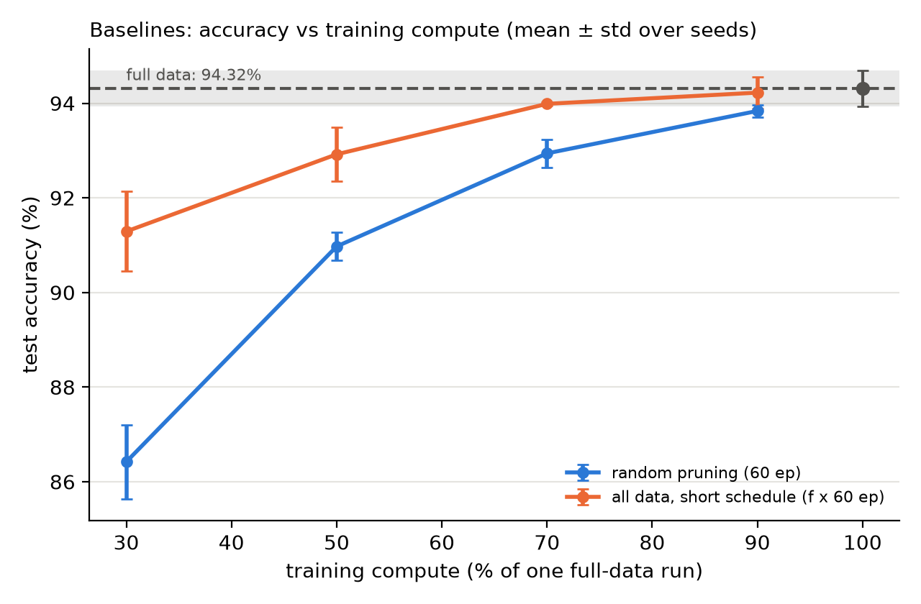
The gap grows as the budget shrinks
RESULTS
Drop in accuracy compared with all data (94.32%):
−0.5
points: random 90% gets 93.84 (94.32 − 93.84)
−7.9
points: random 30% gets 86.42 (94.32 − 86.42)
−3.0
points: all data for 18 epochs gets 91.29 (94.32 − 91.29), the same time as keeping 30%
DataDiet · CS 725 mid-term
12
Notes:
This plot shows the same baseline numbers as a picture. Across is the training budget, as a share of one full run. Up is test accuracy. The dashed line at the top is all the data, 94.32%.
The numbers on the right are each "all-data accuracy minus that run's accuracy":
- Random 90%: 94.32 minus 93.84, about half a point lost. Almost free.
- Random 30%: 94.32 minus 86.42, almost 8 points lost.
- All data for 18 epochs, the same time as keeping 30%: 94.32 minus 91.29, only 3 points lost.
So with the same small budget, it is much better to see every picture a few times than to see a few pictures many times. The blue line, random, falls away much faster than the orange line, fewer epochs.
This is a fair comparison: both lines use exactly the same amount of training work at each point. It also sets the bar for our pruning method: it should beat random picking, and ideally beat simply training for fewer epochs.

Slide 13
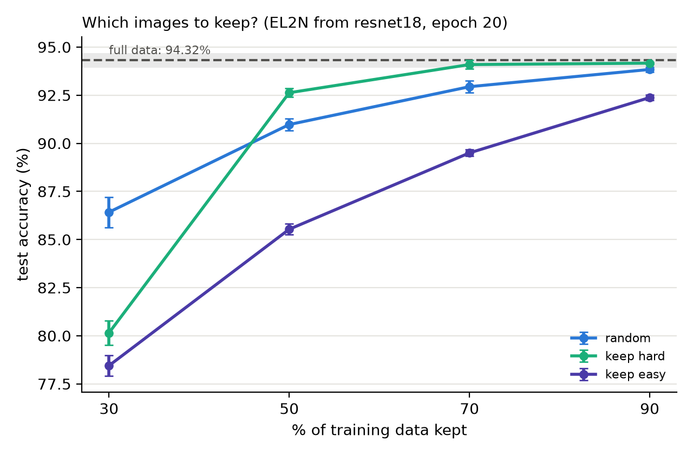
Keeping hard images beats random, until 30%
RESULTS
Kept | Hard | Random
90% | 94.16 | 93.84
70% | 94.09 | 92.94
50% | 92.63 | 90.97
30% | 80.15 | 86.42
Hard 70% is only 0.23 below full data (94.32).
Keep-easy is worst at every % of training data kept.
DataDiet · CS 725 mid-term
13
Notes:
This is our main result. We used the EL2N scores to keep the hardest pictures, and compared with random picking at the same size.
At 90%, keep-hard gets 94.16% against 93.84% for random. At 70%, 94.09% against 92.94%. At 50%, 92.63% against 90.97%. In all three cases keeping the hard pictures wins, by 0.3 to 1.7 points. We checked these differences with a statistics test, Welch's t-test, and they are real, not luck.
The best part: keeping the hardest 70% gives 94.09%, only 0.23 below using all the data. By our definition, that is a good subset in terms of accuracy: 30% less data, almost no loss.
But at 30% it flips. Keep-hard falls to 80.15%, more than 6 points below random. The next slide explains why.
Keeping the easiest pictures, shown in the plot, is the worst at every size. Easy pictures repeat what the model already knows, so they teach it little.

Slide 14
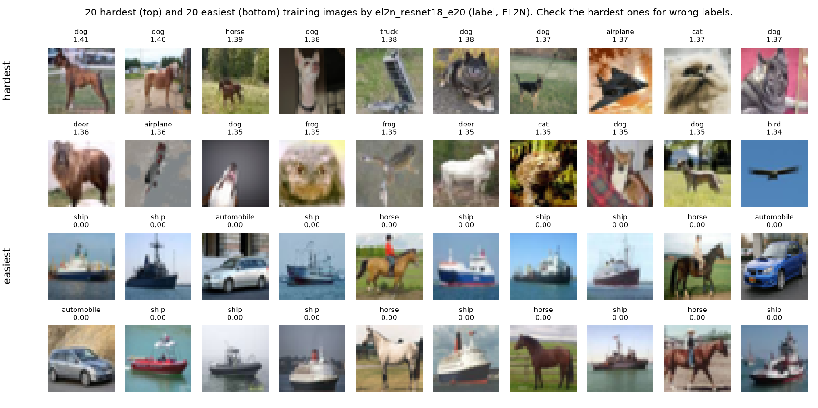
Why 30% fails: the hardest images are messy
RESULTS
Kept per class, hard 30%
Class | Images
Cats | 2,790
Dogs | 2,441
Ships | 841
Cars | 666
Even share | 1,500
Two problems: many unclear or wrongly labelled pictures, and far more cats and dogs than cars and ships after pruning.
DataDiet · CS 725 mid-term
14
Notes:
Two reasons explain why keeping only the hardest 30% fails.
Reason one, on the left: these are real CIFAR-10 pictures ranked by our scores. The easiest are clear and typical. The hardest are messy: blurry animals that could be a cat or a dog, strange angles, tiny objects, and some that look wrongly labelled. If we keep only the hardest 30%, a big part of the training data is like this, and almost no clean, typical examples are left. The model never properly learns what a normal car or cat looks like.
Reason two, the table: the classes become unbalanced. CIFAR-10 has 5,000 pictures per class, so a fair 30% share is 1,500 per class. But keep-hard kept 2,790 cats and 2,441 dogs, because cats and dogs are easily confused with each other. It kept only 841 ships and 666 cars, because those are easy. So the model sees too few cars and ships.
This matches a known paper by Sorscher and colleagues: when you keep very little data, the hardest pictures alone are the wrong choice. Both problems point to fixes we test after the mid-term.

Slide 15
Measured: the scorer costs more than a full run
RESULTS
Scorer | Train, ep. 1–20 | EL2N | Total
seed 1000 | 54.16 s | 0.67 s | 54.83 s
seed 1001 | 54.75 s | 0.67 s | 55.42 s
seed 1002 | 54.85 s | 0.67 s | 55.52 s
S (sum) |  |  | 165.8 s
F = one full run
= 2.38 min = 143.0 s
165.8 / 143.0
S = 1.16 F
DataDiet · CS 725 mid-term
15
Notes:
So far we looked at accuracy. Now the time, which is the heart of our project. We did not estimate it; we measured it.
How we measured: inside the training code, a stopwatch runs around every epoch. Before reading the clock we wait until the GPU has really finished its work, so the time is accurate. Adding up all the epochs gives the training time of a run. Scoring is timed separately in the same way.
F, one full run on all the data for 60 epochs, is the average of our three full runs: 143 seconds, or 2.38 minutes.
The table shows the three scorers. Each one took about 54 to 55 seconds to train for 20 epochs, plus 0.67 seconds to score all 50,000 pictures. One set of scores needs all three scorers, so we add them up: S is 165.8 seconds.
165.8 divided by 143.0 is 1.16. So making the scores takes 1.16 times as long as training the final model once on all the data, before training on the subset has even started.
Why not exactly 1.0, since 3 times 20 epochs is 60 epochs? The first job on each GPU is slower while the GPU warms up, and each scorer was such a first job. Without that warm-up, S is about the same as F. Either way, scoring alone costs about one full training run.

Slide 16
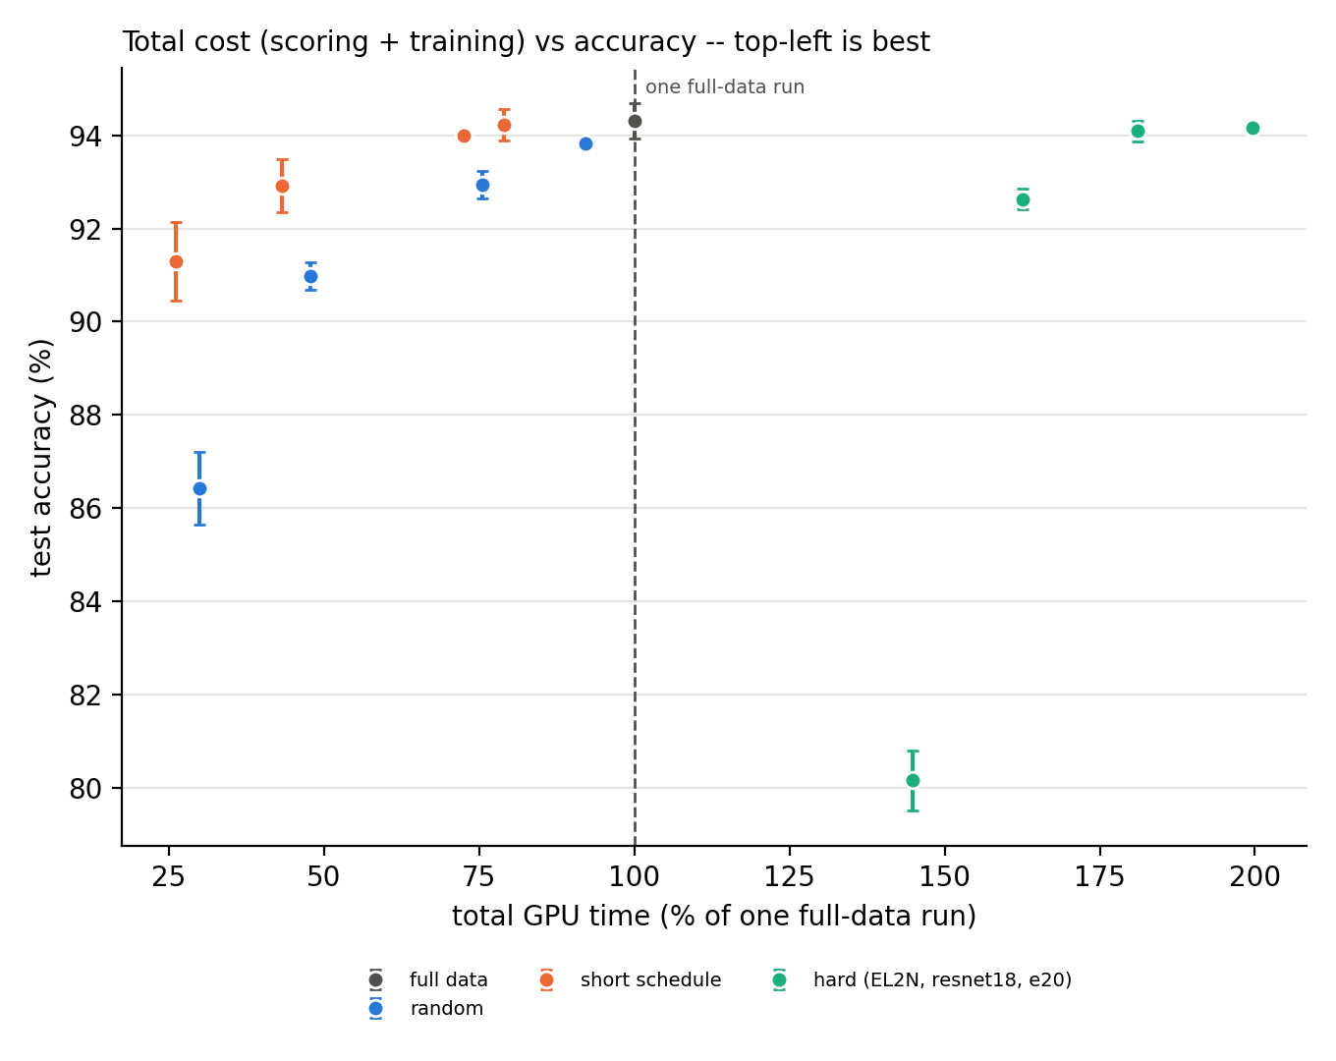
Counting the scoring cost changes the story
RESULTS
Across: total time (scoring + training), as % of one full run. Up: accuracy. Top-left is best.
Green (keep-hard) points cost 145–200%: the scores alone already cost 116%.
Example, keep-hard 50%: (2.76 + 1.11 min) ÷ 2.38 min = 163%.
To save time we would need f < 1 − 1.16 = −0.16. Impossible: this scorer never pays for itself.
DataDiet · CS 725 mid-term
16
Notes:
This graph puts time and accuracy together.
How to read it: across is the total time of a run, scoring plus training, as a percentage of one full run. Up is accuracy. The best place is the top-left corner: high accuracy, little time. The dashed line is one full run, 100%.
Left of the line are all data, random picking in blue, and fewer epochs in orange. They need no scores, so their time is only training. Orange is above blue everywhere: for the same time, fewer epochs is more accurate than random picking.
Right of the line are all the keep-hard runs, in green. Before keep-hard trains anything, it has already spent 116% of a full run on scoring. Then it trains on the kept pictures. For example, keep-hard 50%: 2.76 minutes of scoring plus 1.11 minutes of training is 3.87 minutes, and 3.87 divided by 2.38 is 163%. The green points land between 145% and 200%.
So the best green points are as accurate as all data, but take about twice as long.
The box at the bottom: to save time we need f smaller than 1 minus 1.16, which is minus 0.16. You cannot keep a negative share of the data, so with this scorer, pruning can never save time. The accuracy side works; the whole problem is the cost of the scorer. That is exactly what we work on next.

Slide 17
Four lessons from the mid-term
WHAT WE LEARNED
1 · Hard beats random at 90–50%
2 · Hard collapses at 30%
3 · Training shorter is a strong rival
4 · The standard scorer costs too much
DataDiet · CS 725 mid-term
17
Notes:
Four lessons from the mid-term.
One: keeping the hard pictures beats random picking when we keep 90, 70 or 50% of the data, by 0.3 to 1.7 points, and keeping 70% is only 0.23 below using all the data. So EL2N does find good subsets, as the Data Diet paper said.
Two: it collapses at 30%, 80.2% against 86.4% for random, because the hardest pictures are messy and the classes become unbalanced.
Three: simply training on all the data for fewer epochs is a strong rival. It beats random picking at every budget. Any pruning method should be compared with it, not only with random.
Four: the standard scorer costs too much. Making the scores takes 1.16 full training runs, so with this scorer, pruning never saves time for a single training run.
These lessons lead directly to our plan: make the scorer cheaper, and fix the 30% problem.

Slide 18
Plan 1: make the scorer cheaper
AFTER MID-TERM
Score earlier: take EL2N at epoch 1 or 5 instead of epoch 20. Why: the scorer’s time grows with every epoch, so early scores cost far less.
Use a small scorer: a tiny network, about 100 times smaller than ResNet-18. Why: much less work per picture. Does a weak model still know which pictures are hard?
Compare with the mid-term reference: do the cheap scores still beat random, and does scoring + training finally take less than one full run?
Goal: bring the scoring time well below one full training run, so that pruning finally saves time.
DataDiet · CS 725 mid-term
18
Notes:
After the mid-term, the first part of our work is the main idea of the project: making the scorer cheap.
Score earlier: instead of taking the EL2N score at epoch 20, take it at epoch 1 or epoch 5. The scorer's time grows with every epoch, so an early score costs far less. If early scores still pick nearly the same hard pictures, we get the same benefit for much less time.
Use a small scorer: instead of ResNet-18, use a tiny network, about 100 times smaller. It does far less work per picture. The open question is whether a weak model still knows which pictures are hard.
For both, we compare with our mid-term reference: do the cheap scores still beat random picking, and does scoring plus training finally take less than one full run? That is the goal: bring the scoring time well below one full training run, so that pruning actually saves time.

Slide 19
Plan 2: fix the 30% problem and check our results
AFTER MID-TERM
Skip the very hardest
Balance the classes
Forgetting score
Drop the hardest 5% first (often wrongly labelled), then keep the next hardest.
Keep the same share of every class: at 30% we kept 2,790 cats but only 666 cars.
A second way to measure “hard”: do our findings depend on EL2N alone?
CIFAR-100
Same rules
100 classes, 500 pictures each: do our findings hold on harder data?
Same recipe, 3 repeats, compared with random and fewer epochs, total time counted.
.
DataDiet · CS 725 mid-term
19
Notes:
The second part fixes the 30% problem and checks that our findings are solid.
Skip the very hardest: many of the hardest pictures are unclear or wrongly labelled, so we first drop the hardest 5%, then keep the next hardest.
Balance the classes: at 30% we kept 2,790 cats but only 666 cars. Class-balanced pruning keeps the same share from every class.
Forgetting score: a second way to measure "hard", which counts how often the model gets a picture right and then wrong again. If our findings also hold with this score, they do not depend on EL2N alone.
CIFAR-100: the same kind of pictures, but 100 classes with only 500 pictures each. A harder test of whether our findings hold.
And the same rules as the mid-term: same recipe, three repeats, compared with random and with fewer epochs, and the total time always counted.

Slide 20
The papers our idea comes from
PRIOR WORK
Paper | Where
Paul, Ganguli, Dziugaite: Deep Learning on a Data Diet | NeurIPS 2021
Toneva et al.: An Empirical Study of Example Forgetting | ICLR 2019
Coleman et al.: Selection via Proxy | ICLR 2020
Sorscher et al.: Beyond Neural Scaling Laws | NeurIPS 2022
DataDiet · CS 725 mid-term
20
Notes:
Finally, the four papers our project builds on. The titles on the slide are links to the papers.
Deep Learning on a Data Diet, by Paul, Ganguli and Dziugaite, NeurIPS 2021: our main paper, and where our team name comes from. It introduced the EL2N score and showed that a score taken early in training can find pictures that are safe to remove.
An Empirical Study of Example Forgetting, by Toneva and colleagues, ICLR 2019: it counts how often a model forgets a picture during training. That is our second way to measure "hard".
Selection via Proxy, by Coleman and colleagues, ICLR 2020: it showed that a small or briefly trained helper model can choose data almost as well as the big model, much faster. That is the idea behind our cheap scorer.
Beyond Neural Scaling Laws, by Sorscher and colleagues, NeurIPS 2022: it showed that if you keep a lot of data you should keep the hard pictures, but if you keep very little, easier pictures work better. That explains our 30% result.
What these papers mostly do not report is how long the scoring takes. That is what our project adds.

Slide 21
Thank you
Notes:
To sum up in one sentence: keeping the hard pictures works well when we keep 70 to 50% of the data, but the standard scorer takes more time than it saves, so the next step is to make the scorer cheap.
Thank you. We are happy to take questions.
Likely questions and short answers:
Q: If training for fewer epochs wins, why do this project?
A: For one training run with the standard scorer, yes, training shorter wins, and we show that clearly. Pruning can still pay when the scorer is cheap, when the same pruned data is reused for many training runs so the scoring cost is shared, or when less data is useful in itself, for example less storage or finding wrongly labelled pictures. Our numbers give the exact condition for when it pays.
Q: Is it fair to compare 50% of the data with 30 epochs?
A: Yes. Both do exactly the same amount of training work: half the pictures for 60 epochs, or all the pictures for 30 epochs. The measured GPU times are also about the same, 68 and 62 seconds.
Q: How did you measure time?
A: A stopwatch around every epoch in the training code, after waiting for the GPU to finish, on the same kind of GPU for every run. F is the average of our three full runs; S is the sum of the three scorers.
Q: Why CIFAR-10 and ResNet-18, and why 60 epochs?
A: They are the standard setting in pruning papers, and one run takes about 2.4 minutes. 60 epochs already gives 94.3%, and every method gets the same 60 epochs, so it is fair.
Q: Are 3 repeats enough?
A: Enough to see the main effects; the statistics test says our key differences are not luck.
Q: Why does keep-hard fail at 30%?
A: The hardest pictures are often unclear or wrongly labelled, and the classes become very unbalanced.

